Slide 1
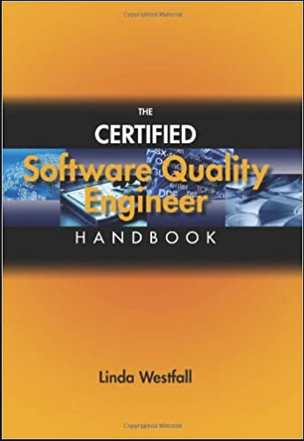
Software Testing & Quality Engineering
Chapter 1
An Introduction
Linda Westfall Quality Press

Slide 2
About the Course
3 Credits
Audience:
Software Engineering
Computer Science Technology
Information Management
Previous Courses:
Software Engineering (CMP 3310)
Principle of Management
Text book
The Certified Software Quality Engineer by Linda Westfall, Quality Press; (September 28, 2009), ISBN-10: 0873897307
Course Code:
SE-3341
Course Structure:
Lectures: 3/ Labs: 0
Course Objectives
The objective of this course is to make students have ability to understand Software Quality Engineering concepts and practice.

Slide 3
Course Organization
1. Introduction to Quality
2. Ethical & Legal compliance
3. Standards and Models
4. Leadership Skills
5. Team Skills
6. Quality Management System
7. Methodologies for Quality Management
8. Audits
9. Project Tracking & Control
11. Testing Planning and Design
10. Software Verification & Validation
12. Reviews and Inspections
13. Test Execution Documentation
14. Customer Deliverables
15. Configuration Management

Slide 4
Objectives
Introduction to Quality
Quality Principles
Benefits of Quality
Organization and Process Benchmarking

Slide 5
Introduction
Software (following 4 characteristics)
- Invisibility - Complexity - Conformity - Flexibility
Engineering
1950-1960 (Mongolian Hordes Method) – myth was adding programmers will recover the lost schedule time. The philosophy of that era was “The completed code will always be full of defects. The coding should be ﬁnished quickly to correct these defects. Design as you code approach.” This was referred to as software crises. This led to the birth of software engineering with an understanding that programming is different from science and mathematics.
Programmers are like engineers because they build software products. The education of classical engineers include product design and math, whereas, computer science put emphasis on latest technologies. (Bridges collapsed in large number in 19th centaury). Refer to Fig. 1.1 on next page.
Notes:
Invisibility: With software, progress is not immediately visible
Complexity: Per dollar, software products contain more complexity than other engineered artefacts
Conformity: Software developers have to conform to the requirements of human clients
Flexibility: Software systems are particularly subject to change
- With reference to Mongolian Hordes approach, Brooks says adding people to a late software project actually makes it later.
- Software Crises: There were problems with budget and schedule overruns, as well as the quality and reliability of the delivered software.

Slide 6
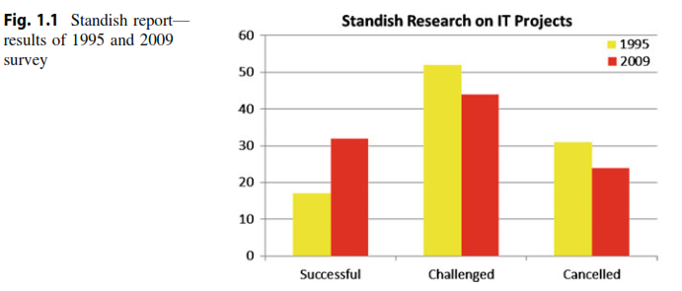
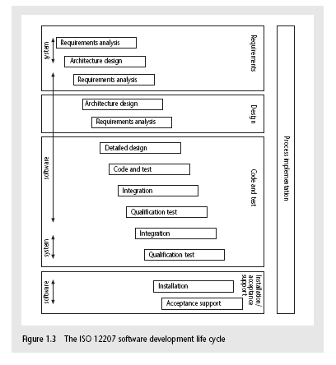
Introduction continued
Poor software quality can lead to defects in the software that may adversely impact the customer and even lead to loss of life. It is therefore essential that software development organizations place sufﬁcient emphasis on quality throughout the software development lifecycle
Notes:
The Standish group has conducted research (Fig. 1.1) on the extent of problems with IT projects since the mid-1990s. These studies were conducted in the USA, but there is no reason to believe that European or Asian companies perform any better. The results indicate serious problems with on-time delivery of projects and projects being cancelled prior to completion.2 However, the comparison between 1995 and 2009 suggests that there have been some improvements with a greater percentage of projects being delivered successfully and a reduction in the percentage of projects being cancelled.

Slide 7
Introduction continued
Quality
Quality means different things to different people and in different situations. This list gives some of the informal definitions of quality:
Quality is not a program; it is an approach to business.
Quality is a collection of powerful tools and concepts that are proven to work.
Quality is defined by customers through their satisfaction.
Quality includes continual improvement and breakthrough events.
Quality tools and techniques are applicable in every aspect of business.
Quality is aimed at perfection; anything less is an improvement opportunity.
Quality increases customer satisfaction, reduces cycle time and costs, and eliminates errors and rework.
Quality is not just for businesses. It works in nonprofit organizations such as schools, healthcare and social services, and government agencies.
Notes:
The banker will answer” service”
The healthcare worker will answer “quality health care”
The hotel employee will answer “customer satisfaction”
The manufacturer will simply answer “quality product”

Slide 8
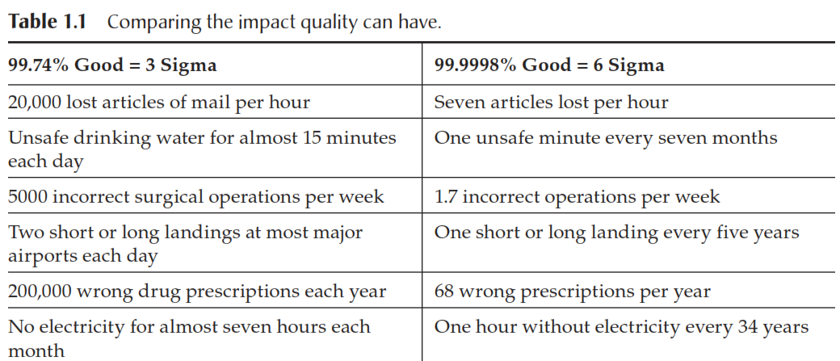
Impact of Quality
Results—performance and financial—are the natural consequence of effective quality management.
Table 1.1 compares the consequences and impact of quality management at two different quality levels, three sigma and six sigma.

Slide 9
Quality Defined
(ISO 8402)
Quality: the totality of features and characteristics of a product or service that bear on its ability to satisfy stated or implied needs. Not to be mistaken for “degree of excellence” or “fitness for use” which meet only part of the definition.
The views of eight well-known quality experts appear in the July 2001 issue of Quality Progress
Quality improvement is a never-ending process.
Top management commitment, knowledge, and active participation are critical.
Management is responsible for articulating a company philosophy, goals, measurable objectives, and a change strategy.
All employees in the organization need to be active participants.
A common language and set of procedures are important to communicate and support the quality effort.
A process must be established to identify the most critical problems, determine their causes, and find solutions.
Changes in company culture, roles, and responsibilities may be required.
Joseph Juran
Quality = fitness for use
Philip Crosby
Quality = conformance to specifications

Slide 10
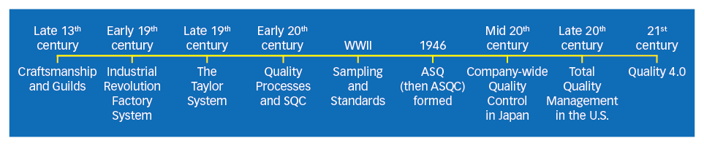
Quality Timeline – A brief History
The quality movement can trace its roots back to medieval Europe, where craftsmen began organizing into unions called guilds in the late 13th century. These guilds were responsible for developing strict rules for product and service quality. Inspection committees enforced the rules by marking flawless goods with a special mark or symbol. This changed dramatically with the Industrial Revolution / Factory system (started from Europe and adopted by US).
The factory system, with its emphasis on product inspection, started in Great Britain. With new factory systems craftsman became factory worker and forced shop owners to become production supervisors. Quality was ensured through skill of laborers supplemented by audits / inspections.
Late in 19th centaury US came with a new approach devised by Fredrick W. Taylor, whose goal was to increase productivity without increasing the number of skilled craftsmen. He achieved this by assigning factory planning to specialized engineers and by using craftsmen and supervisors as inspectors and managers who executed the engineers’ plans. Though goal of increased productivity was achieved but with increase in negative quality. To remedy the quality decline, factory managers created inspection departments to keep defective products from reaching customers.1900 Mass Inspections, 1930 Control Charts.
With World War II, US moved from a civilian economy to military production. Quality became critical and an important safety issue. Inspecting each piece became too tedious, therefore armed forces began to use Sampling inspection. Sampling tables were published in military standards, and now suppliers clearly understood what they were supposed to deliver.
The beginning of the 20th century marked the inclusion of "processes" in quality practices. A "process" is defined as a group of activities that takes an input, adds value to it, and provides an output. Walter Shewhart began to focus on controlling processes in the mid-1920s, making quality relevant not only for the finished product but for the processes that created it. Shewhart recognized that industrial processes yield data. Shewhart determined this data could be analyzed using statistical techniques to see whether a process is stable and in control, or if it is being affected by special causes that should be fixed. In doing so, Shewhart laid the foundation for control charts, a modern-day quality tool.
The birth of total quality management in the United States was in direct response to a quality revolution in Japan following World War II, as major Japanese manufacturers converted from producing military goods for internal use to producing civilian goods for trade. Japan’s strategies represented the new "total quality" approach. Rather than relying purely on product inspection, Japanese manufacturers focused on improving all organizational processes through the people who used them. As a result, Japan was able to produce higher-quality exports at lower prices, benefiting consumers throughout the world. (Edwards demming and Joseph Juran did wonders in Japan Quality advancements)
Notes:
https://asq.org/quality-resources/history-of-quality#guilds

Slide 11
Principles of Quality
1. Customer Focus
2. Leadership
3. Involvement of People
4. Process Approach
5. Systematic Approach to Management
6. Continual Improvement
7. Factual Approach to Decision-Making
8. Mutually Beneficial Supplier Relationships*
Let’s walk through them one by one...

Slide 12
Principle 1: Customer Focus understand, strive to meet and exceed customer expectations.*
Organizations depend on their customers and should
understand needs, current & future
meet / exceed those needs
to achieve
business performance & effectiveness
customer loyalty
through
market / customer research
alignment of objectives with needs
measurement of customer satisfaction
balance among needs / interests of all stakeholders

Slide 13
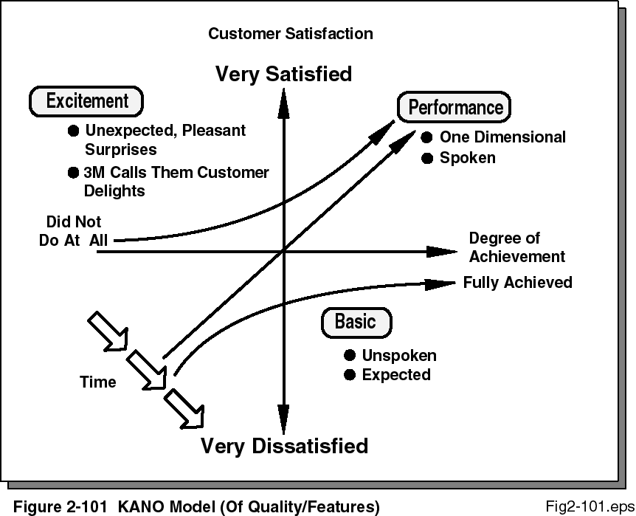
Principle 1: Customer Focus understand, strive to meet and exceed customer expectations.*
Quality is “perceived” according to Kano
Think about what delights you as a customer
From: Ludwig-Becker, M., Electronics Quality Management Handbook, McGraw-Hill, 1997, p.67 from Juran and Gyrna, Quality Planning and Analysis, 3rd Ed. McGraw-Hill, 1993,p. 247, used with permission

Slide 14
Principle 2: Leadership unity, purpose, and involvement*
Leaders establish
unity of purpose and direction
environment where people are involved
to achieve
communication, motivation, alignment
organization’s objectives
through
considering needs of all parties
vision, values, goals, targets, etc
fairness, respect, ethics, trust (elim. fear)
providing resources, removing road-blocks
inspiring, encouraging, recognizing

Slide 15
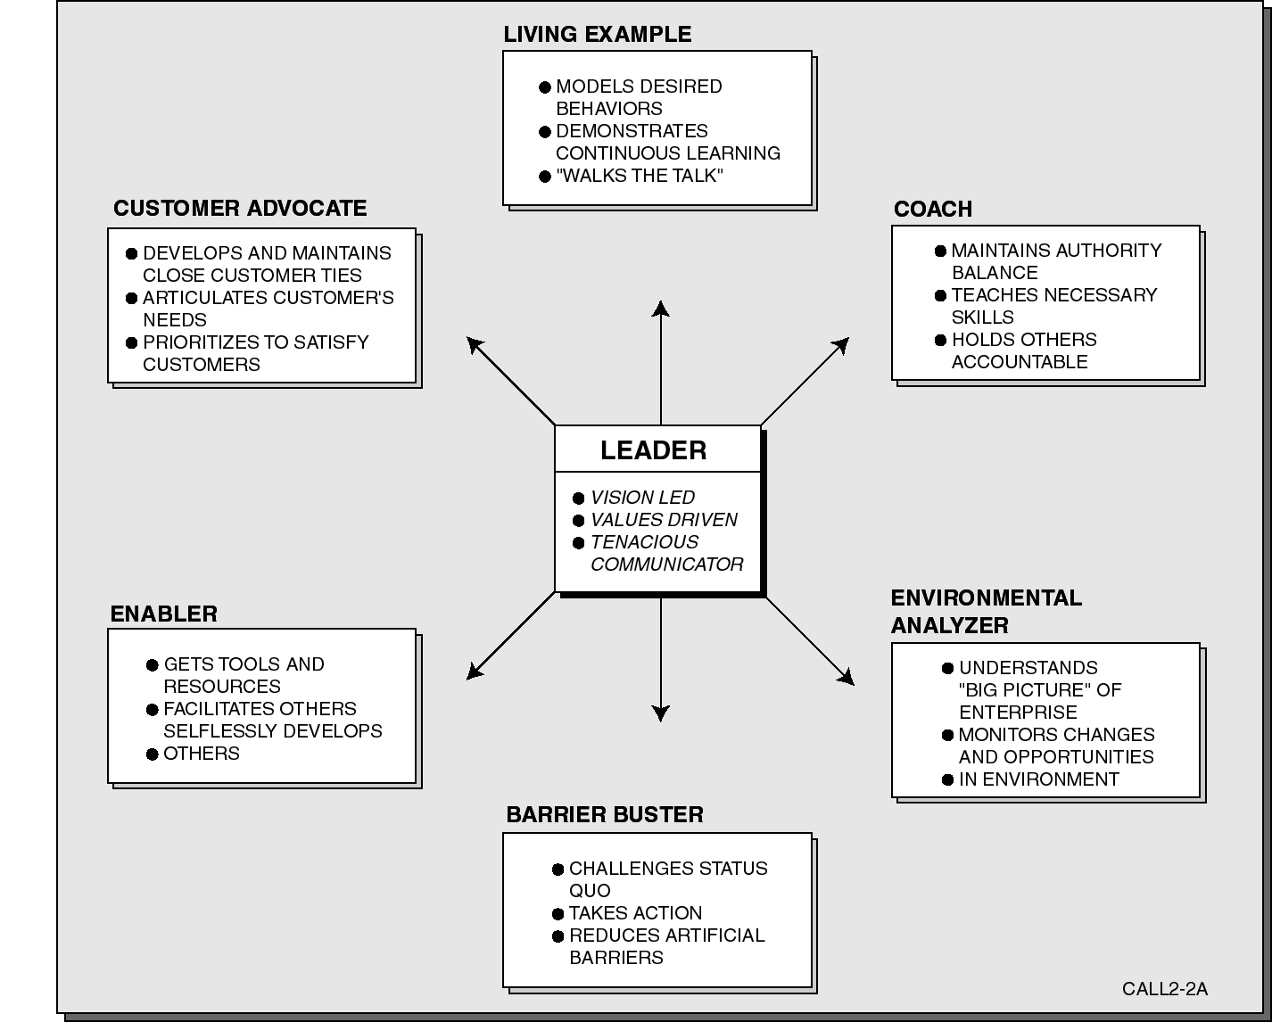
Vision Led Value Driven Leadership

Slide 16
Principle 3: People Involvement People...are the essence of the organization...
People at all levels
are the essence
their full involvement
organization’s benefit (& those of it’s stakeholders)
to achieve
motivation, innovation, creativity
accountability, participation, contribution
through their understanding of
their roles and goals
importance of their contributions
strengths, opportunities, knowledge, experience
constraints, issues, problems (trust)

Slide 17
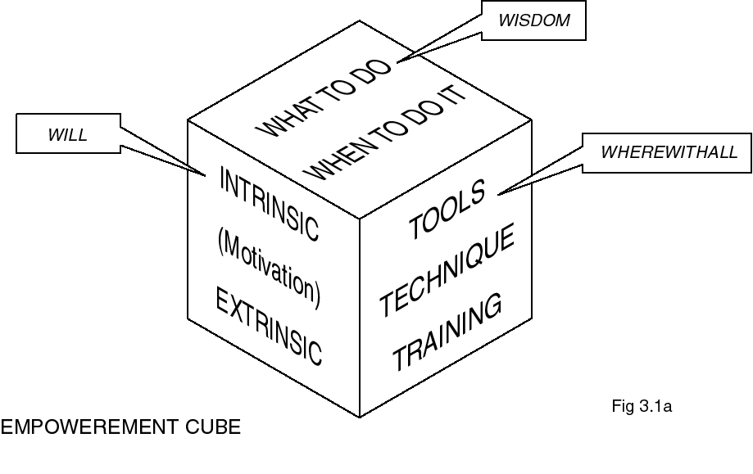
Principle 3: People Involvement People...are the essence of the organization...
Three facets of empowerment (each depends on the others)
Knowledge of what to do, when to do it
Will to do what needs to be done
The wherewithal to do it
Figure 3.1a: The Empowerment Cube
*Guest Editorial, by John Troyer, Quality Digest, Oct. 1996, p. 64

Slide 18
Principle 4: Process Approach... related resources and activities are managed as a process.*
A process approach
achieves desired results more efficiently
manages related resources, activities, etc. as a process
to achieve
lower costs, reduce cycle times
consistency, predictability... improvement
through
defining result... process... inputs...
responsibility, accountability, measurement / analysis
identifying interfaces, interdependencies
focus on critical factors, best opportunities, risks, etc/
Notes:
Product = Output
All Inputs required - Processes

Slide 19
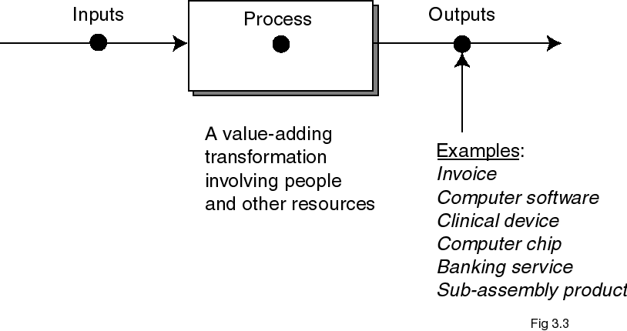
Principle 4: Process Approach... related resources and activities are managed as a process.*
Everything done is involved in a process
Suppliers... Inputs... Process... Outputs... Customers (SIPOC)
Voice of the customer loops back to beginning (PDCA)
Note: Figure 3.3 from ISO 9000-1: 1994, p. 4

Slide 20
Principle 5: Systems Approach... managing a system [for] effectiveness and efficiency*
Systems are
collections of interrelated processes
their interfaces, interdependences, etc.
that are best managed as a whole (system)
to achieve
efficiency, effectiveness, improvement
confidence in capability
through
thorough definition and understanding
especially of the KEY processes
measurement, evaluation
responsibility accountability
Notes:
Time limits - Penalty

Slide 21
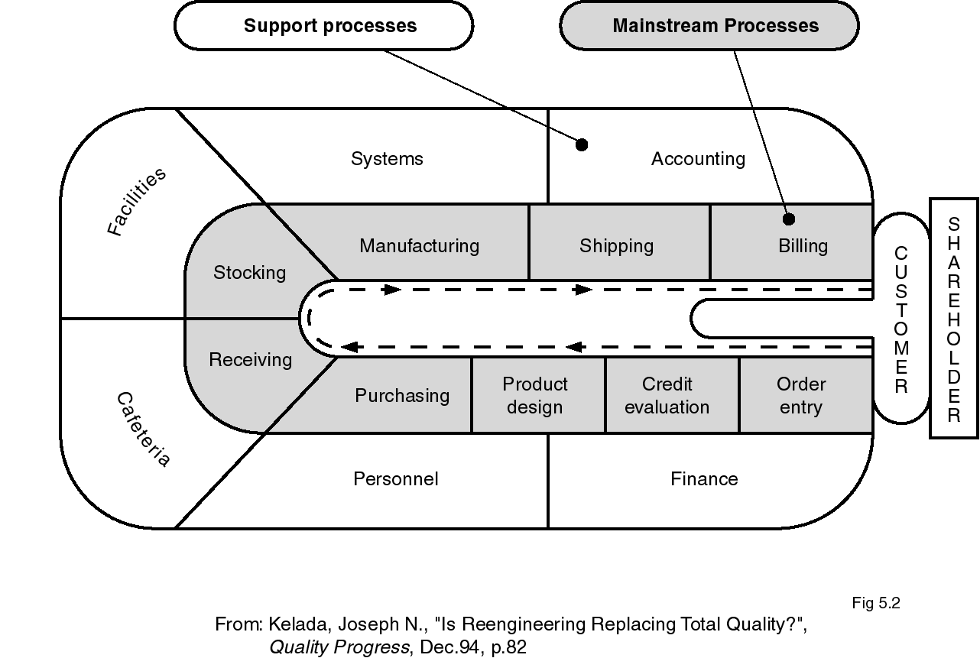
Principle 5: Systems Approach... managing a system [for] effectiveness and efficiency*

Slide 22
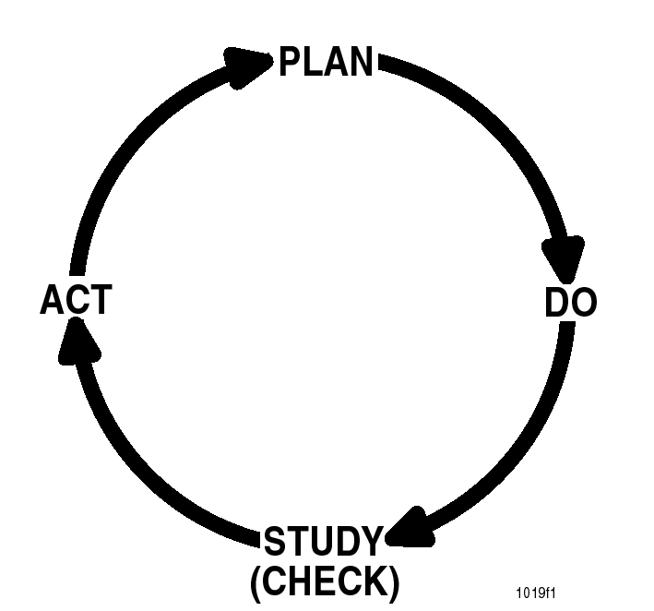
Principle 6: Continual Improvement... the object of an organization that wishes to stay in business.*
Continual improvement
in overall performance
permanent objective
improving
capability, flexibility
alignment, agility
through
see above...
and below

Slide 23
Principle 6: Continual Improvement
Phases of continuous process improvement (see next chart)
Awareness, Resistance, Expansion, Integration and finally Regeneration, or Continuous Improvement
Strategies for Implementation
1. Commitment
2. Training
3. Targeting and Deployment
4. Resources
5. Measurements
6. Management Structure
7. Systems Alignment
8. Communication and Information*
*Doherty, Steve D., “A Blueprint for Excellence”, Quality Progress, April 1991, p. 84-85

Slide 24
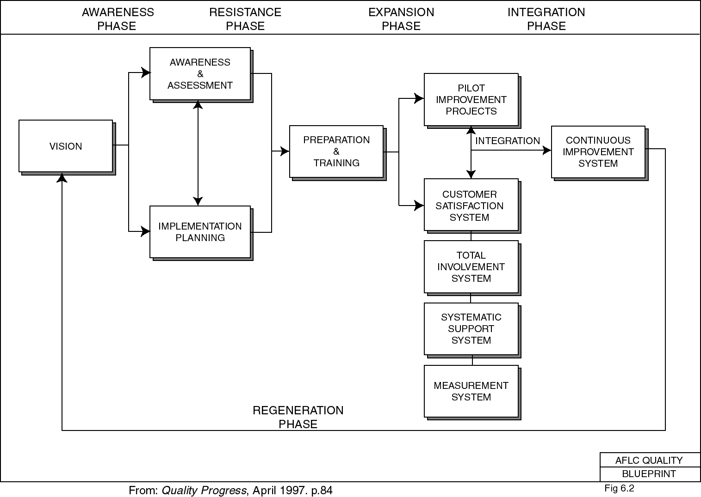
Principle 6: Continual Improvement Example for Excellence at the Air Force Logistics Command (AFLC)

Slide 25
Principle 7: Factual Approach... based on.. analysis of data and information.*
“Can’t manage what you can’t measure”
“In God we trust. All others, bring data”
supports improvement
better decisions, results
verifiable gains, means to hold them
Measure, collect data
Analyze it
Make results available
Use them

Slide 26
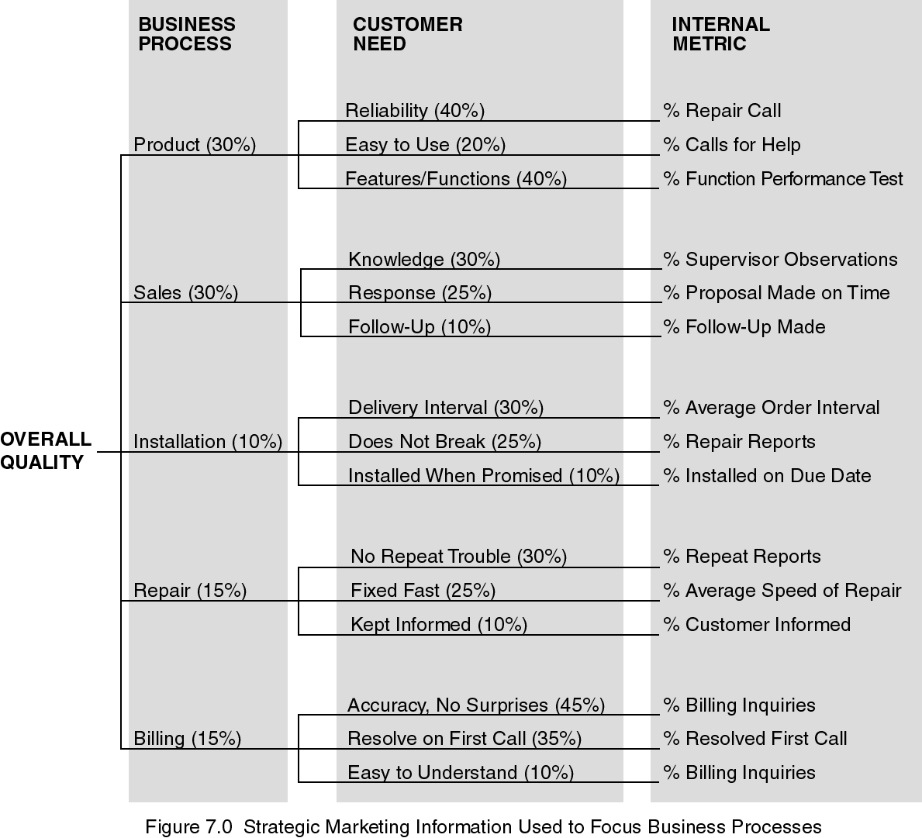
Principle 7: Factual Approach to Decision-Making Measuring Business Processes
From: Kordupleski, R., Rust, R, and Zahorik, A, “Why Improving Quality Doesn’t Improve Quality”, California Management Review, vol.38, no. 3, Spring 1993, p. 91

Slide 27
Principle 8: Mutually Beneficial Supplier Relationships enhance the ability of the organization to create value.*
A Win-Win approach
Both organizations can create more value
Better flexibility, speed, optimization
Balance short / long term
Pool expertise, share information
Better communication
Joint efforts
Mutual respect, recognition

Slide 28
Benefits of Quality
Strengthened competitive position.
Adaptability to changing or emerging market conditions and to environmental and other government regulations.
Higher productivity.
Enhanced market image.
Elimination of defects and waste.
Reduced costs and better cost management.
Higher profitability.
Improved customer focus and satisfaction.
Increased customer loyalty and retention.
Increased job security.
Improved employee morale.
Enhanced shareholder and stakeholder value.
Improved and innovative processes.

Slide 29
Process Improvement: Example
W1
Why material did not reach in time?
A1
It was dispatched late
W2
Why dispatched late
A2
Material was not ready on time
W3
Why it was not ready on time
A3
Material specifications reached late
W4
Why specification came late
A4
Specification were not sent with PO
W5
Why not received with PO
A5
Purchase person he missed to send it together
W6
Why the person missed
A6
The purchase person was new and was not trained properly

Slide 30
Process Improvement and Benchmarking
Software process improvement (SPI) methodology is defined as a sequence of tasks, tools and techniques to plan and implement improvement activities to achieve specific goals such as increasing development speed, achieving higher product quality or reducing costs.
Software process improvement is a set of activities that will lead to a better software process and in result higher quality software delivered in a more timely manner.
Assessment and Gap Analysis:
Assessment allows you to analyze the current working process i.e. current strength and weaknesses.
The difference between local application and best practice represents a “GAP”, that offer opportunities for improvement.
SPI Approach is iterative and continuous but it can be viewed in five quick look steps.
Assessment of current software process.
Education and training of practitioners and managers
Selection and justification of process elements, software engineering methods and tools.
Implementation of the SPI plan.
Evaluation and tuning based on the results of the plan.
Notes:
The people who champion SPI comes form three groups: Technical Managers, Software engineers and individuals who have quality assurance responsibility.
SPI Approach is iterative and continuous but it can be viewed in five quick look steps.
Assessment of current software process.
Education and training of practitioners and managers
Selection and justification of process elements, software engineering methods and tools.
Implementation of the SPI plan.
Evaluation and tuning based on the results of the plan.

Slide 31
Benchmarking
Benchmarking allows you to compare the performance of your software development/maintenance project to other projects in the IT industry.
This is valuable given that other IT organisations employ best practices and are considered to be the “best in industry”.
Benchmarking clearly shows key performance areas that require improvement as you aim for excellence in productivity. Your aim is to maintain Quality and Customer Satisfaction as project performance is improved.
Essentially a benchmark is a comparative study with at least one another source of performance data. This may be quantitative or qualitative.
A Typical Benchmark
A typical benchmark could contain factors such as:
Development productivity (hours/function point)
Time to market (months/1000FP)
Defects/1000 function points
Customer satisfaction
% on time
% on budget
% change requests (measure by FP/ delivered FP
Notes:
Measuring, comparing to competition, and identifying opportunities for improvements are the essence of benchmarking.
Benchmarking is practice of being :Humble enough to understand that someone else is better at something. And being wise enough to learn how to match and even surpass that.
LOC = 5000
LOC/day = 500
Total time = 10

Slide 32
Types of Benchmarking
Product Benchmark | Compare product or services
Strategic Benchmark | Compare organizational structures, management practices, and business strategies
Internal Benchmark | Compare similar products or services of similar business units within one organization.
Competitive Benchmark | Compares performance with a direct competitor. Objects under investigation can be: Products, services, technology, research and development, personnel policies, etc.
Collaborative | Across industries (Wall-mart and dell example)

